Slide 1

Spark Your Learning
Grade 5 • Lesson 17.1 – Understand Decimal Division Patterns
Copyright © by Houghton Mifflin Harcourt Publishing Company
All rights reserved. No part of the material protected by this copyright may be reproduced or utilized in any form or by any means, electronic or mechanical, including photocopying, recording, broadcasting or by any other information storage and retrieval system, without written permission of the copyright owner unless such copying is expressly permitted by federal copyright law.
Only those pages that are specifically enabled by the program and indicated by the presence of the print icon may be printed and reproduced in classroom quantities by individual teachers using the corresponding student’s textbook or kit as the major vehicle for regular classroom instruction. Requests for information on other matters regarding duplication of this work should be submitted through our Permissions website at https://customercare.hmhco.com/contactus/Permissions.html or mailed to Houghton Mifflin Harcourt Publishing Company, Attn: Compliance, Contracts, and Licensing, 9400 Southpark Center Loop, Orlando, Florida 32819-8647.
HOUGHTON MIFFLIN HARCOURT and the HMH Logo are trademarks and service marks of Houghton Mifflin Harcourt Publishing Company. You shall not display, disparage, dilute or taint Houghton Mifflin Harcourt trademarks and service marks or use any confusingly similar marks, or use Houghton Mifflin Harcourt marks in such a way that would misrepresent the identity of the owner. Any permitted use of Houghton Mifflin Harcourt trademarks and service marks inures to the benefit of Houghton Mifflin Harcourt Publishing Company.
All other trademarks, service marks or registered trademarks appearing on Houghton Mifflin Harcourt Publishing Company websites are the trademarks or service marks of their respective owners.
Notes:
This PowerPoint file contains instructional aids for teachers who have purchased the Into Math program and who are implementing the Spark Your Learning task in the classroom. It is intended to be projected to students and used in conjunction with the Student Edition and manipulatives as needed. These slides can be used to move the conversation forward in the classroom, but they should not serve as a replacement for student-centered, collaborative conversations in which students have the space they need to find an entry point, construct meaning, and build understanding.
GRADE 5 LESSON 17.1: In this Spark Your Learning task, students will engage in discourse focused on exploring how to:
1.) Find patterns in quotients when dividing by powers of 10.

Slide 2

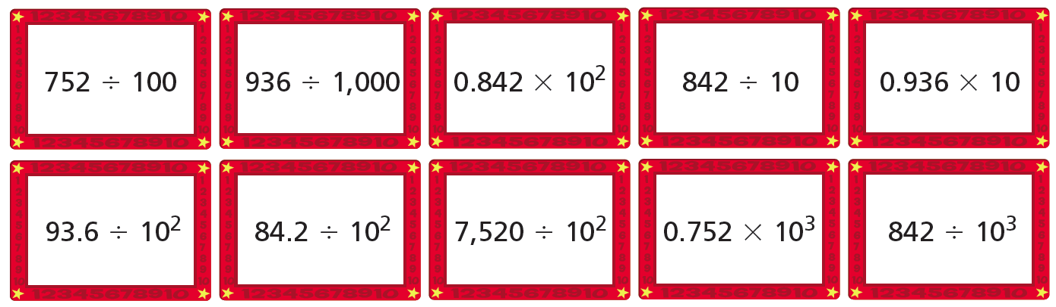
Spark Your Learning
Jada is playing a sorting game with a deck of math cards.
Each card has an expression on one side.
She lays out 10 of the cards.
Sort the expressions on the cards
into three categories.
Categories
Less than 1
Between 1 and 10
Greater than 10
© Houghton Mifflin Harcourt Publishing Company
Image Credit: ©Patti McConville/Alamy
Spark Your Learning
Motivate
Workspace
Persevere
Strategy 1
Strategy 2
Common Error
Turn & Talk
Notes:
Use this slide to present the task to students.

Slide 3
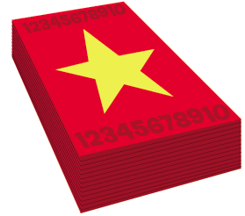
Get Motivated
What are some card games you have played in which you had to sort cards into categories?
How can multiplication patterns help you solve these problems?
  47,000 × 1000 =
  47,000 × 100 =
  47,000 × 10 =
  47,000 × 1 =
  47,000 × 0.1 =
  47,000 × 0.01 =
  47,000 × 0.001 =
47,000,000
4,700,000
470,000
47,000
4,700.0
470.00
47.000
© Houghton Mifflin Harcourt Publishing Company
Spark Your Learning
Motivate
Workspace
Persevere
Strategy 1
Strategy 2
Common Error
Turn & Talk
Notes:
OPTIONAL: Use the questions on this slide to engage students.
Click to reveal the answers to the multiplication problems, which are a review of content from Module 15.
You may need to remind students that 47,000 can also be written as 47,000.000

Slide 4
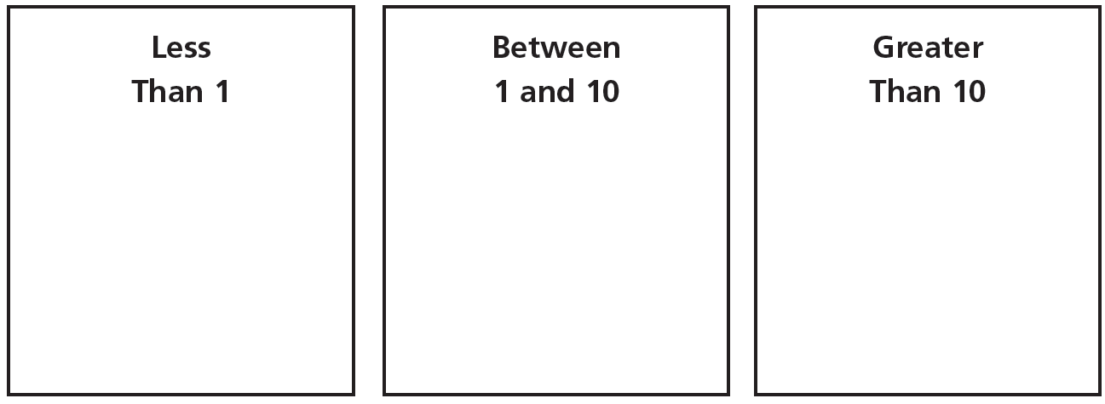
Workspace
Jada is playing a sorting game with a deck of math cards. Each card has an expression on one side. She lays out 10 of the cards.
Sort the expressions on the cards in the boxes.
© Houghton Mifflin Harcourt Publishing Company
Spark Your Learning
Motivate
Workspace
Persevere
Strategy 1
Strategy 2
Common Error
Turn & Talk
Notes:
Less than 1
936 ÷ 1,000
93.6 ÷ 10²
84.2 ÷ 10²
842 ÷ 10³
Between 1 and 10
752 ÷ 100
0.936 x 10
Greater than 10
0.842 x 10²
842 ÷ 10
7,520 ÷ 10²
0.752 x 10³

Slide 5
Persevere
What operations are shown in the expressions on the cards?
The operations shown are __________________________.
What do you notice about the dividends in the division expressions?
I notice that _____________________________________.
What do you notice about the divisors in the division expressions?
I notice that _____________________________________.
How can you use mental math to find the values of the expressions?
I can use mental math by ___________________________.
Why is mental math a good strategy to find the values of these expressions?
Mental math is a good strategy because _______________.
Jada is playing a sorting game with a deck of math cards. Each card has an expression on one side. She lays out 10 of the cards.
Sort the expressions on the cards in the boxes.
© Houghton Mifflin Harcourt Publishing Company
Spark Your Learning
Motivate
Workspace
Persevere
Strategy 1
Strategy 2
Common Error
Turn & Talk
Notes:
What operations are shown in the expressions on the cards? multiplication; division
What do you notice about the dividends in the division expressions? Possible answer: Some dividends are whole numbers; others are decimals.
What do you notice about the divisors in the division expressions? Possible answer: They are all powers of 10, and some divisors are written in exponential form.
How can you use mental math to find the values of the expressions? Possible answer: You can use patterns of division and multiplication with powers of 10.
Why is mental math a good strategy to use to find the values of these expressions? Possible answer: Mental math is a good strategy because the divisors are all powers of 10 and I can use place value and patterns to quickly and efficiently evaluate the expressions.
BUILD SHARED UNDERSTANDING Select students who have used various strategies and tools to share with the class how they solved the problem. Have students discuss why they chose a specific strategy or tool.

Slide 6
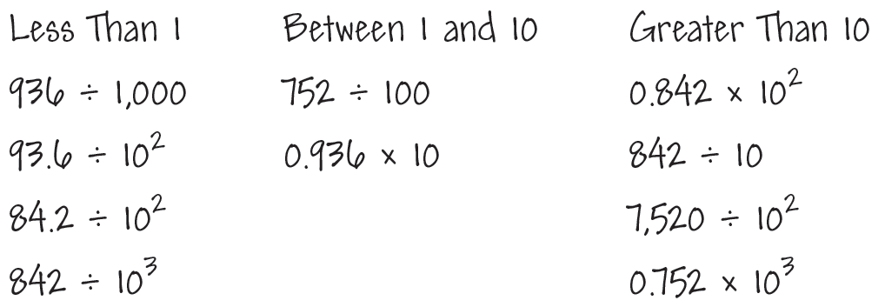
Analyze an Answer
Analyze this student’s work. Do you think this student is correct? Why or why not?
© Houghton Mifflin Harcourt Publishing Company
Spark Your Learning
Motivate
Workspace
Persevere
Strategy 1
Strategy 2
Common Error
Turn & Talk
Notes:
This is a possible correct representation.
If students . . . sort the expressions correctly using mental math, they exhibit exemplary understanding of division and multiplication patterns with powers of 10.
Have these students . . . share and explain how they sorted the cards using division and multiplication patterns.
Ask:
-How did you know how to find the quotients and products by using mental math?

Slide 7
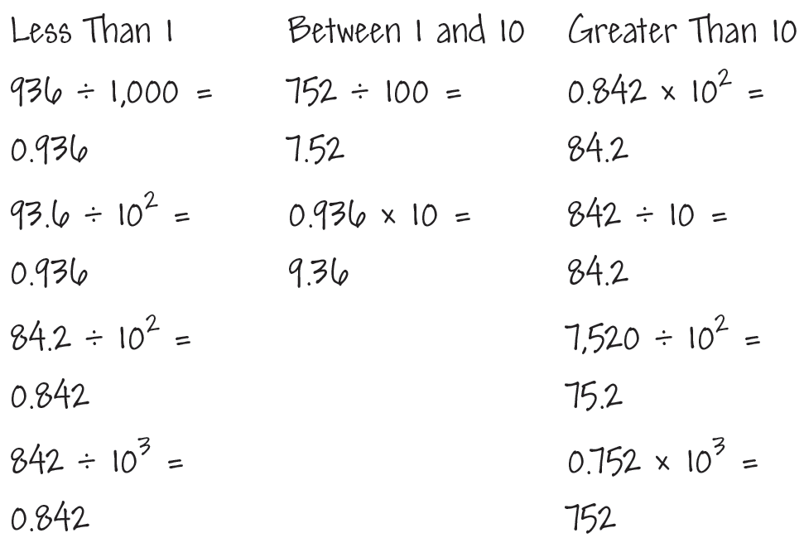
Analyze an Answer
Analyze this student’s work. Do you think this student is correct? Why or why not?
© Houghton Mifflin Harcourt Publishing Company
Spark Your Learning
Motivate
Workspace
Persevere
Strategy 1
Strategy 2
Common Error
Turn & Talk
Notes:
This is a possible correct representation.
If students . . . find the quotients and products by performing calculations, they are not using the most efficient strategy.
Activate prior knowledge . . . by reminding these students that dividing and multiplying by powers of 10 can usually be done mentally.
Ask:
-How could you sort 936 ÷ 1,000 without writing the quotient?
-How could you sort 0.936 x10 without writing the product?

Slide 8
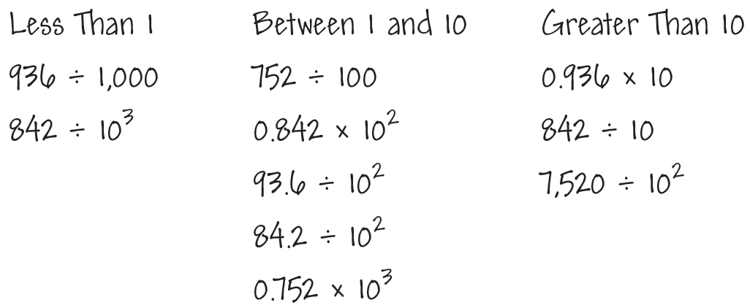
Analyze an Answer
Analyze this student’s work. Do you think this student is correct? Why or why not?
© Houghton Mifflin Harcourt Publishing Company
Spark Your Learning
Motivate
Workspace
Persevere
Strategy 1
Strategy 2
Common Error
Turn & Talk
Notes:
This is an incorrect representation where a student sorts expressions with decimals incorrectly.
If students . . . sort the expressions involving whole-number dividends and factors correctly but not the expressions involving decimals, they are not extending division and multiplication patterns with whole numbers to decimals.
Then intervene . . . by reminding these students that they can use patterns to divide and multiply whole numbers by powers of 10. The same patterns can be used to divide and multiply decimals by powers of 10.
Ask:
-How can you use division patterns to find 936 ÷ 100?
-How can you use division patterns to find 93.6 ÷ 100?

Slide 9

Share Your Thinking
Turn and Talk How can you use place value to determine the value of the 7 in the quotient 752 ÷ 100?
Jada is playing a sorting game with a deck of math cards. Each card has an expression on one side. She lays out 10 of the cards.
Sort the expressions on the cards in the boxes.
© Houghton Mifflin Harcourt Publishing Company
Spark Your Learning
Motivate
Workspace
Persevere
Strategy 1
Strategy 2
Common Error
Turn & Talk
Notes:
Encourage students to share their reasoning. For students who are struggling, suggest that they perform the division on paper and analyze the divisor and quotient.
Possible answer: Since the place value of 7 in the dividend is 7 hundreds, dividing by 100 changes the place value by two places, so the 7 in the quotient is 7 ones.

