Slide 1

Spark Your Learning
Grade 4 • Lesson 17.1 – Identify and Draw Perpendicular and Parallel Lines
Copyright © by Houghton Mifflin Harcourt Publishing Company
All rights reserved. No part of the material protected by this copyright may be reproduced or utilized in any form or by any means, electronic or mechanical, including photocopying, recording, broadcasting or by any other information storage and retrieval system, without written permission of the copyright owner unless such copying is expressly permitted by federal copyright law.
Only those pages that are specifically enabled by the program and indicated by the presence of the print icon may be printed and reproduced in classroom quantities by individual teachers using the corresponding student’s textbook or kit as the major vehicle for regular classroom instruction. Requests for information on other matters regarding duplication of this work should be submitted through our Permissions website at https://customercare.hmhco.com/contactus/Permissions.html or mailed to Houghton Mifflin Harcourt Publishing Company, Attn: Compliance, Contracts, and Licensing, 9400 Southpark Center Loop, Orlando, Florida 32819-8647.
HOUGHTON MIFFLIN HARCOURT and the HMH Logo are trademarks and service marks of Houghton Mifflin Harcourt Publishing Company. You shall not display, disparage, dilute or taint Houghton Mifflin Harcourt trademarks and service marks or use any confusingly similar marks, or use Houghton Mifflin Harcourt marks in such a way that would misrepresent the identity of the owner. Any permitted use of Houghton Mifflin Harcourt trademarks and service marks inures to the benefit of Houghton Mifflin Harcourt Publishing Company.
All other trademarks, service marks or registered trademarks appearing on Houghton Mifflin Harcourt Publishing Company websites are the trademarks or service marks of their respective owners.
Notes:
This PowerPoint file contains instructional aids for teachers who have purchased the Into Math program and who are implementing the Spark Your Learning task in the classroom. It is intended to be projected to students and used in conjunction with the Student Edition and manipulatives as needed. These slides can be used to move the conversation forward in the classroom, but they should not serve as a replacement for student-centered, collaborative conversations in which students have the space they need to find an entry point, construct meaning, and build understanding.
GRADE 4 LESSON 17.1: In this Spark Your Learning task, students will engage in discourse focused on exploring how to:
1.) Identify and draw perpendicular and parallel lines.

Slide 2


Spark Your Learning
A news station’s drone pilot is flying a drone over a neighborhood as part of a news story. The images that
the drone captures reveal intersecting lines, parallel lines,
and perpendicular lines. How can you show each of these
terms in this picture of a neighborhood?
Draw and label lines to show your thinking.
© Houghton Mifflin Harcourt Publishing Company
Spark Your Learning
Motivate
3 Reads
Workspace
Persevere
Strategy 1
Strategy 2
Common Error
Turn & Talk
Notes:
Use this slide to present the task to students.

Slide 3
Get Motivated
Have you ever taken a ride in a helicopter or an airplane?
Have you ever looked out the window of a tall building?
© Houghton Mifflin Harcourt Publishing Company
Spark Your Learning
Motivate
3 Reads
Workspace
Persevere
Strategy 1
Strategy 2
Common Error
Turn & Talk
Notes:
OPTIONAL: Use the questions on this slide to engage students.

Slide 4
Three Reads
First Read What is the situation about?
Possible answer: look for lines in a picture of a neighborhood
Second Read What are the quantities in the situation?
none
Third Read What are possible mathematical questions that you could ask for the situation?
Possible questions:
What is the difference between intersecting lines, parallel
lines, and perpendicular lines?
What objects in the picture look like lines and what objects look like line segments?
Our question to think about: How can you show each of these terms in this picture of a neighborhood?
A news station’s drone pilot is flying a drone over a neighborhood as part of a news story. The images that the drone captures reveal intersecting lines, parallel lines, and perpendicular lines.
© Houghton Mifflin Harcourt Publishing Company
Spark Your Learning
Motivate
3 Reads
Workspace
Persevere
Strategy 1
Strategy 2
Common Error
Turn & Talk
Notes:
OPTIONAL: Use the 3 Reads Language Routine to help students understand the question.

Slide 5

Workspace
A news station’s drone pilot is flying a drone over a neighborhood as part of a news story. The images that the drone captures reveal intersecting lines, parallel lines, and perpendicular lines. How can you show each of these terms in this picture of a neighborhood?
Draw and label lines to show your thinking.
© Houghton Mifflin Harcourt Publishing Company
Spark Your Learning
Motivate
3 Reads
Workspace
Persevere
Strategy 1
Strategy 2
Common Error
Turn & Talk
Notes:
Possible answer: Possible answers are shown on the picture in the TE. They include:
Intersecting lines at the fence in the top left
Parallel lines using the road and sidewalk at the right
Perpendicular lines with the driveway and house in the bottom left

Slide 6
Persevere
What objects in the diagram look like lines?
The objects that look like lines are ______________________.
Which tool could you use to determine whether or not an angle is a right angle?
I could use _________________________________________.
How can you determine if lines are parallel without extending the lines beyond the page?
I can ______________________________________________.
A news station’s drone pilot is flying a drone over a neighborhood as part of a news story. The images that the drone captures reveal intersecting lines, parallel lines, and perpendicular lines. How can you show each of these terms in this picture of a neighborhood?
© Houghton Mifflin Harcourt Publishing Company
Spark Your Learning
Motivate
3 Reads
Workspace
Persevere
Strategy 1
Strategy 2
Common Error
Turn & Talk
Notes:
What objects in the diagram look like lines? Possible answers: streets, sidewalks, power lines
Which tool could you use to determine whether or not an angle is a right angle? Students’ choices of strategies or tools will vary; Possible answer: I could use a protractor.
How can you determine if lines are parallel without extending the lines beyond the page? Possible answer: If the lines remain the same distance apart throughout the picture, they should remain the same distance apart beyond the edges of the picture.
BUILD SHARED UNDERSTANDING Select students who used various strategies and tools to share with the class how they solved the problem. Have students discuss why they chose a specific strategy or tool.
Possible answers are shown on the picture in the TE. They include:
Intersecting lines at the fence in the top left
Parallel lines using the road and sidewalk at the right
Perpendicular lines with the driveway and house in the bottom left

Slide 7
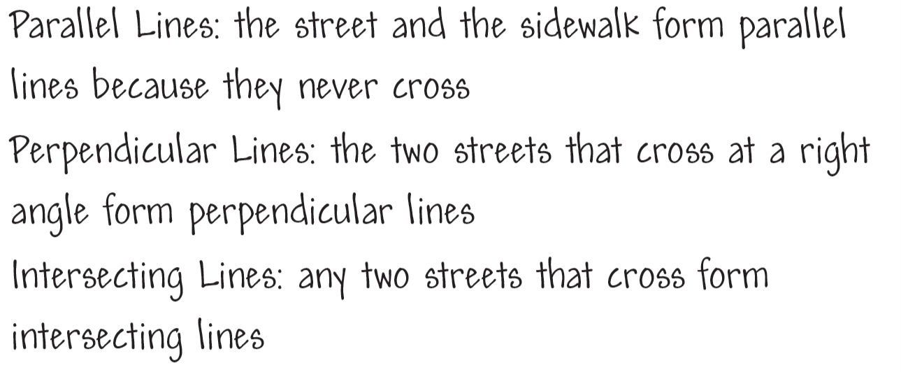
Analyze an Answer
Analyze this student’s work. Do you think this student is correct? Why or why not?
© Houghton Mifflin Harcourt Publishing Company
Spark Your Learning
Motivate
3 Reads
Workspace
Persevere
Strategy 1
Strategy 2
Common Error
Turn & Talk
Notes:
This is a possible correct representation. Possible answer:
Possible answers are shown on the picture in the TE. They include:
Intersecting lines at the fence in the top left
Parallel lines using the road and sidewalk at the right
Perpendicular lines with the driveway and house in the bottom left
If students . . . describe the terms parallel lines, perpendicular lines, and intersecting lines, they are demonstrating conceptual understanding of the different ways that two lines can lie in the same plane and be oriented with respect to each other.
Have these students . . . share and explain how they found examples of the geometric figures. Have these students identify other parallel lines, perpendicular lines, and intersecting lines.
Ask:
- What is the difference between perpendicular lines and intersecting lines?
- What is the difference between perpendicular lines and parallel lines?

Slide 8
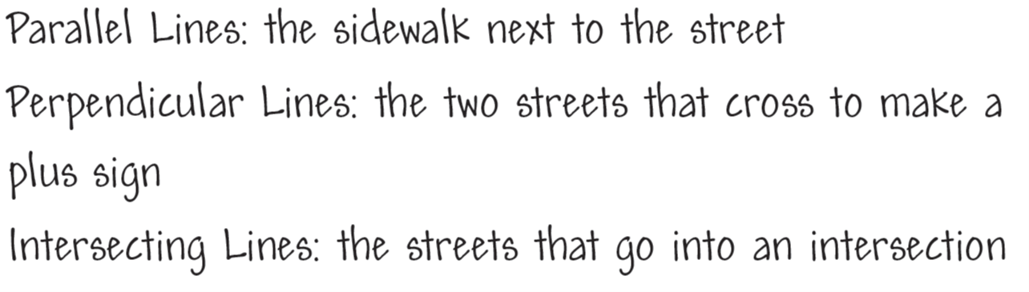
Analyze an Answer
Analyze this student’s work. Do you think this student is correct? Why or why not?
© Houghton Mifflin Harcourt Publishing Company
Spark Your Learning
Motivate
3 Reads
Workspace
Persevere
Strategy 1
Strategy 2
Common Error
Turn & Talk
Notes:
If students . . . identify parallel lines, perpendicular lines, and intersecting lines with partial descriptions, then students may not understand the distinction between some of the terms or may have trouble applying the terms mathematically.
Activate prior knowledge . . . by having students look back at the picture of the neighborhood.
Ask:
- How can you describe two lines that are parallel? How can you describe two lines that are perpendicular?
- How is an intersection formed? How are intersecting lines and perpendicular lines different?

Slide 9
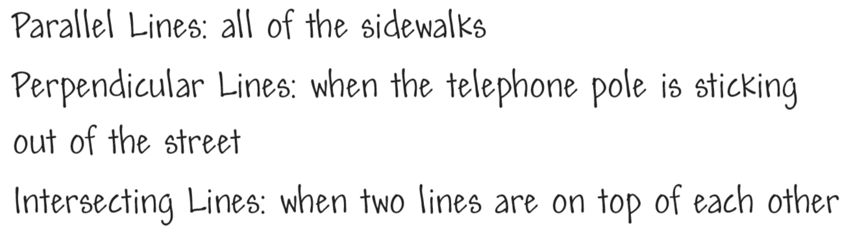
Analyze an Answer
Analyze this student’s work. Do you think this student is correct? Why or why not?
© Houghton Mifflin Harcourt Publishing Company
Spark Your Learning
Motivate
3 Reads
Workspace
Persevere
Strategy 1
Strategy 2
Common Error
Turn & Talk
Notes:
If students . . . incorrectly identify parallel lines, perpendicular lines, and/or intersecting lines or do not provide descriptions, they may not understand the attributes of these figures.
Then intervene . . . by reminding students about the instructions in the problem. Tell them that labeling the diagram is not enough; students need to explain why they placed the labels the way they did.
Ask:
- If you draw two lines on a piece of paper, what are the different ways that the lines can interact?
- How can you draw two lines to make a right angle? How would you classify the two lines?

Slide 10

Share Your Thinking
A news station’s drone pilot is flying a drone over a neighborhood as part of a news story. The images that the drone captures reveal intersecting lines, parallel lines, and perpendicular lines. How can you show each of these terms in this picture of a neighborhood?
Turn and Talk How does your choice for each term compare with the choices of others?
© Houghton Mifflin Harcourt Publishing Company
Spark Your Learning
Motivate
3 Reads
Workspace
Persevere
Strategy 1
Strategy 2
Common Error
Turn & Talk
Notes:
Have students compare their written descriptions and their labels on the pictures.
Answers will vary; Possible answer: Everybody in the group chose different intersecting lines and parallel lines, but most people chose the same perpendicular lines.

