Slide 1

Spark Your Learning
Grade 3 • Lesson 17.1 – Estimate and Measure Liquid Volume
Copyright © by Houghton Mifflin Harcourt Publishing Company
All rights reserved. No part of the material protected by this copyright may be reproduced or utilized in any form or by any means, electronic or mechanical, including photocopying, recording, broadcasting or by any other information storage and retrieval system, without written permission of the copyright owner unless such copying is expressly permitted by federal copyright law.
Only those pages that are specifically enabled by the program and indicated by the presence of the print icon may be printed and reproduced in classroom quantities by individual teachers using the corresponding student’s textbook or kit as the major vehicle for regular classroom instruction. Requests for information on other matters regarding duplication of this work should be submitted through our Permissions website at https://customercare.hmhco.com/contactus/Permissions.html or mailed to Houghton Mifflin Harcourt Publishing Company, Attn: Compliance, Contracts, and Licensing, 9400 Southpark Center Loop, Orlando, Florida 32819-8647.
HOUGHTON MIFFLIN HARCOURT and the HMH Logo are trademarks and service marks of Houghton Mifflin Harcourt Publishing Company. You shall not display, disparage, dilute or taint Houghton Mifflin Harcourt trademarks and service marks or use any confusingly similar marks, or use Houghton Mifflin Harcourt marks in such a way that would misrepresent the identity of the owner. Any permitted use of Houghton Mifflin Harcourt trademarks and service marks inures to the benefit of Houghton Mifflin Harcourt Publishing Company.
All other trademarks, service marks or registered trademarks appearing on Houghton Mifflin Harcourt Publishing Company websites are the trademarks or service marks of their respective owners.
Notes:
This PowerPoint file contains instructional aids for teachers who have purchased the Into Math program and who are implementing the Spark Your Learning task in the classroom. It is intended to be projected to students and used in conjunction with the Student Edition and manipulatives as needed. These slides can be used to move the conversation forward in the classroom, but they should not serve as a replacement for student-centered, collaborative conversations in which students have the space they need to find an entry point, construct meaning, and build understanding.
GRADE 3 LESSON 17.1: In this Spark Your Learning task, students will engage in discourse focused on exploring how to:
1.) Use reasoning and benchmarks to estimate, and use tools to measure liquid volume in liters.
2.) Explain how benchmarks can be used to estimate liquid volume and show how tools can help.

Slide 2

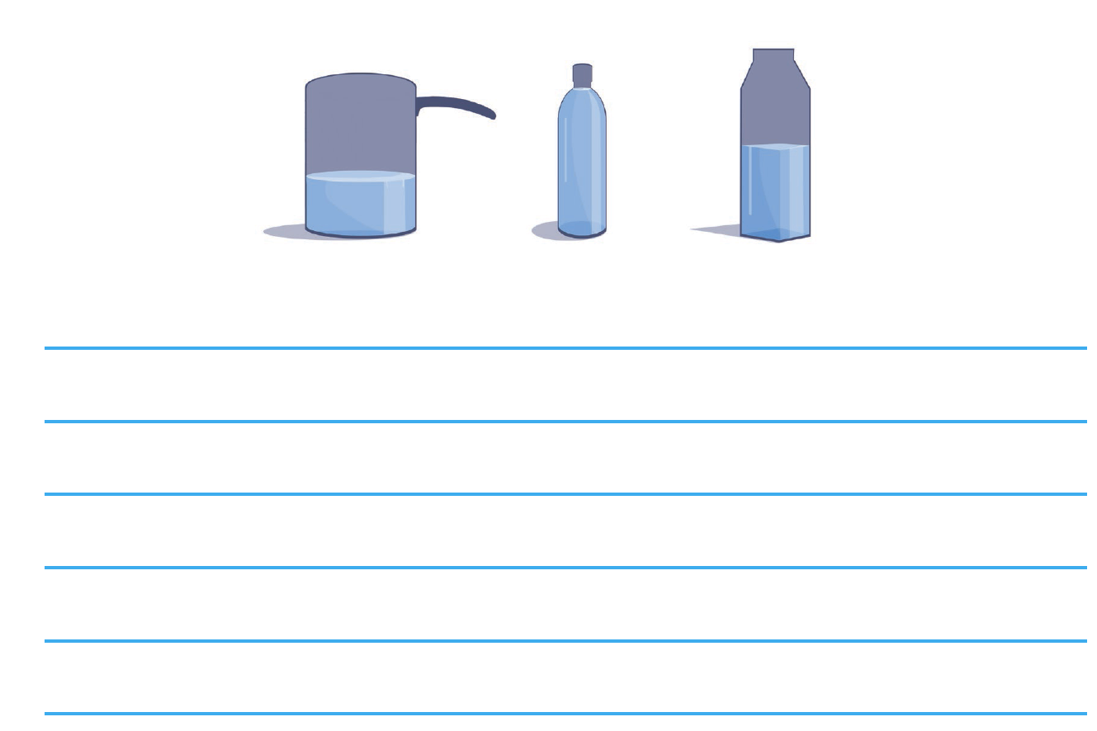
Spark Your Learning
Describe a situation in which each container might have been filled. In each description, be sure to compare the amount of liquid in the container to the size of the container. The same amount of liquid is in each container.
© Houghton Mifflin Harcourt Publishing Company
Spark Your Learning
Motivate
3 Reads
Workspace
Persevere
Strategy 1
Strategy 2
Common Error
Turn & Talk
Notes:
Use this slide to present the task to students.

Slide 3
Get Motivated
How would you describe the amounts of liquid in containers that you have used?
When have you measured liquids?
© Houghton Mifflin Harcourt Publishing Company
Spark Your Learning
Motivate
3 Reads
Workspace
Persevere
Strategy 1
Strategy 2
Common Error
Turn & Talk
Notes:
OPTIONAL: Use the questions on this slide to engage students.

Slide 4
Three Reads
First Read What is the situation about?
Possible answer: comparing the liquid in containers
Second Read What are the quantities in the situation?
the amount of liquid in each container
Third Read What are possible mathematical questions that you could ask for the situation?
Possible questions:
Does one container have more liquid in it than the other containers?
Which container is the largest?
Which container is the smallest?
Which container is full of liquid?
Our question to think about: How was the liquid in each container filled?
Describe a situation in which each container might have been filled. In each description, be sure to compare the amount of liquid in the container to the size of the container. The same amount of liquid is in each container.
© Houghton Mifflin Harcourt Publishing Company
Spark Your Learning
Motivate
3 Reads
Workspace
Persevere
Strategy 1
Strategy 2
Common Error
Turn & Talk
Notes:
OPTIONAL: Use the 3 Reads Language Routine to help students understand the question.

Slide 5
Workspace
Describe a situation in which each container might have been filled. In each description, be sure to compare the amount of liquid in the container to the size of the container. The same amount of liquid is in each container.
© Houghton Mifflin Harcourt Publishing Company
Spark Your Learning
Motivate
3 Reads
Workspace
Persevere
Strategy 1
Strategy 2
Common Error
Turn & Talk
Notes:
Possible description: Bonita is heating up a pot of soup that is less than half full. Kyle fills his water bottle to the top so that it is full for soccer practice. Allie fills an empty milk carton with water up to half full to water some plants.

Slide 6
Persevere
Which of the containers are completely filled with liquid?
_____________ is completely filled with liquid.
Into which of the containers do you think you could pour more liquid? How do you know?
I think I could pour more liquid in ____________________, because _______________________________________.
Which tool could you use to solve the problem? Why is this tool more strategic?
I can use ___________, because ___________________.
Describe a situation in which each container might have been filled. In each description, be sure to compare the amount of liquid in the container to the size of the container. The same amount of liquid is in each container.
© Houghton Mifflin Harcourt Publishing Company
Spark Your Learning
Motivate
3 Reads
Workspace
Persevere
Strategy 1
Strategy 2
Common Error
Turn & Talk
Notes:
Which of the containers are completely filled with liquid? the water bottle
Into which of the containers do you think you could pour more liquid? How do you know? The pot and the milk carton; Possible explanation: Both the pot and the milk carton have empty space so more liquid could be poured in.
Which tool could you use to solve the problem? Why is this tool more strategic? Students’ choices of strategies and tools will vary.
BUILD SHARED UNDERSTANDING Select students who have used various strategies and tools to share with the class how they solved the problem. Have students discuss why they chose a specific strategy or tool.

Slide 7
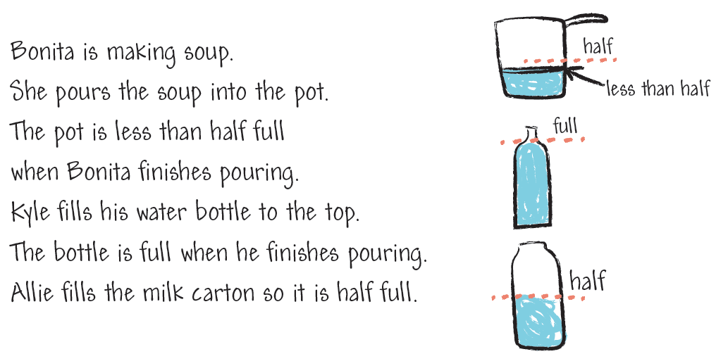
Analyze an Answer
Analyze this student’s work. Do you think this student is correct? Why or why not?
© Houghton Mifflin Harcourt Publishing Company
Spark Your Learning
Motivate
3 Reads
Workspace
Persevere
Strategy 1
Strategy 2
Common Error
Turn & Talk
Notes:
This is a possible correct representation.
If students . . . correctly compare the liquid amount in each container to the size of the container, they are demonstrating exemplary understanding of how liquids fill different container sizes.
Have these students . . . compare the amount of liquid that would fit in each container if it were full.
Ask:
-How did you decide which container could hold the greatest amount of liquid?
-Why did you order that container as the one that can hold the least amount of liquid?

Slide 8
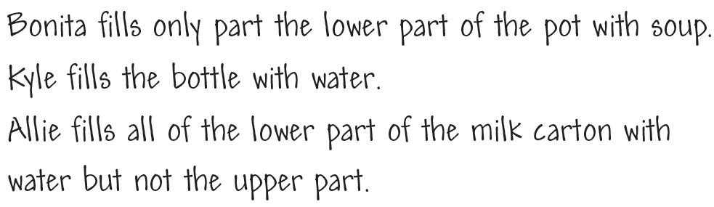
Analyze an Answer
Analyze this student’s work. Do you think this student is correct? Why or why not?
© Houghton Mifflin Harcourt Publishing Company
Spark Your Learning
Motivate
3 Reads
Workspace
Persevere
Strategy 1
Strategy 2
Common Error
Turn & Talk
Notes:
This is a possible correct representation.
If students . . . use everyday rather than quantitative terms to compare the amount of liquid in a container to the container size, these students may be uncertain about using units to make comparisons.
Activate prior knowledge . . . by having these students find and describe more ways to compare each liquid amount and how much of its container it fills.
Ask:
-What did you notice about the amount of space that the liquid took up in the pot? Is the container more than half full? less than half full?
-How does the amount of space left over in each container compare to the others?

Slide 9
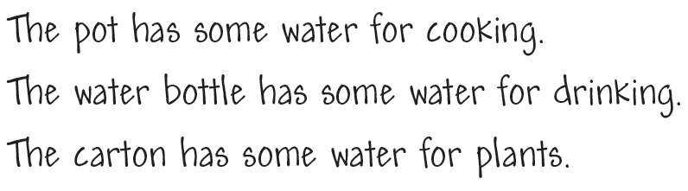
Analyze an Answer
Analyze this student’s work. Do you think this student is correct? Why or why not?
© Houghton Mifflin Harcourt Publishing Company
Spark Your Learning
Motivate
3 Reads
Workspace
Persevere
Strategy 1
Strategy 2
Common Error
Turn & Talk
Notes:
This is an incorrect representation where a student fails to make comparisons.
If students . . . describe each amount without comparing it to the size of its container, they may not be comfortable making comparison statements about relative amounts.
Then intervene . . . by asking students to focus on how the amount the container is full compares to the amount it is empty. Have students use water and containers to act out pouring the same amount into each container.
Ask:
-Was the pot filled completely when you poured the amount of liquid into it?
-Which containers had a lot of space remaining inside after you poured in the liquid? Is the container more than half full? less than half full?

Slide 10

Share Your Thinking
Turn and Talk Which container can hold the
greatest amount of liquid? Which container holds the least amount of liquid? Explain.
Describe a situation in which each container might have been filled. In each description, be sure to compare the amount of liquid in the container to the size of the container. The same amount of liquid is in each container.
© Houghton Mifflin Harcourt Publishing Company
Spark Your Learning
Motivate
3 Reads
Workspace
Persevere
Strategy 1
Strategy 2
Common Error
Turn & Talk
Notes:
Encourage students to compare how much the different containers can hold. Have students explain how to compare the containers by which can hold the greatest amount of liquid and which holds the least amount of liquid.
Possible answer: The pot and milk carton can hold more liquid than the water bottle. The pot can hold the greatest amount of liquid, and the water bottle can hold the least amount of liquid. The liquid fills less than half of the pot, about half of the carton, and fills the water bottle. There is more space in the pot and the milk carton for more liquid.

