Slide 1

Spark Your Learning
Grade 2 • Lesson 17.1 – Represent Three-Digit Subtraction
Copyright © by Houghton Mifflin Harcourt Publishing Company
All rights reserved. No part of the material protected by this copyright may be reproduced or utilized in any form or by any means, electronic or mechanical, including photocopying, recording, broadcasting or by any other information storage and retrieval system, without written permission of the copyright owner unless such copying is expressly permitted by federal copyright law.
Only those pages that are specifically enabled by the program and indicated by the presence of the print icon may be printed and reproduced in classroom quantities by individual teachers using the corresponding student’s textbook or kit as the major vehicle for regular classroom instruction. Requests for information on other matters regarding duplication of this work should be submitted through our Permissions website at https://customercare.hmhco.com/contactus/Permissions.html or mailed to Houghton Mifflin Harcourt Publishing Company, Attn: Compliance, Contracts, and Licensing, 9400 Southpark Center Loop, Orlando, Florida 32819-8647.
HOUGHTON MIFFLIN HARCOURT and the HMH Logo are trademarks and service marks of Houghton Mifflin Harcourt Publishing Company. You shall not display, disparage, dilute or taint Houghton Mifflin Harcourt trademarks and service marks or use any confusingly similar marks, or use Houghton Mifflin Harcourt marks in such a way that would misrepresent the identity of the owner. Any permitted use of Houghton Mifflin Harcourt trademarks and service marks inures to the benefit of Houghton Mifflin Harcourt Publishing Company.
All other trademarks, service marks or registered trademarks appearing on Houghton Mifflin Harcourt Publishing Company websites are the trademarks or service marks of their respective owners.
Notes:
This PowerPoint file contains instructional aids for teachers who have purchased the Into Math program and who are implementing the Spark Your Learning task in the classroom. It is intended to be projected to students and used in conjunction with the Student Edition and manipulatives as needed. These slides can be used to move the conversation forward in the classroom, but they should not serve as a replacement for student-centered, collaborative conversations in which students have the space they need to find an entry point, construct meaning, and build understanding.
GRADE 2 LESSON 17.1 In this Spark Your Learning task, students will engage in discourse focused on exploring how to:
1.) Solve problems involving three-digit subtraction by building concrete and visual models.
2.) Explain how to use place value and concrete models to solve subtraction problems with three-digit numbers.

Slide 2


Spark Your Learning
Noura and Matt play a video game. Noura’s points total has 3 hundreds, 8 tens, 7 ones. Matt’s points total is 5 tens 3 ones less than Noura’s points total.
What is Matt’s point total? Show your work with a visual model.
© Houghton Mifflin Harcourt Publishing Company
Spark Your Learning
Motivate
3 Reads
Workspace
Persevere
Strategy 1
Strategy 2
Common Error
Turn & Talk
Notes:
Use this slide to present the task to students.

Slide 3
Get Motivated
What do you know about video games?
What video games have you played? What do you like about them?
Look at the students’ faces. How do you think they are feeling? Why?
© Houghton Mifflin Harcourt Publishing Company
Spark Your Learning
Motivate
3 Reads
Workspace
Persevere
Strategy 1
Strategy 2
Common Error
Turn & Talk
Notes:
OPTIONAL: Use the questions on this slide to engage students.

Slide 4
Three Reads
First Read What is the problem about?
Possible answer: Noura and Matt are playing a video game.
Second Read What do each of the numbers describe?
Noura has 3 hundreds, 8 tens, and 7 ones for points. Matt’s points total is 5 tens and 3 ones less than Noura’s.
Third Read What math questions could you ask about the problem?
Possible questions:
How many points did Matt score in all?
How can you show subtracting hundreds from hundreds, tens from tens, and ones from ones to solve?
Our question to think about: What is Matt’s point total?
Noura and Matt play a video game. Noura’s points total has 3 hundreds, 8 tens, 7 ones. Matt’s points total is 5 tens 3 ones less than Noura’s points total.
© Houghton Mifflin Harcourt Publishing Company
Spark Your Learning
Motivate
3 Reads
Workspace
Persevere
Strategy 1
Strategy 2
Common Error
Turn & Talk
Notes:
OPTIONAL: Use the 3 Reads Language Routine to help students understand the question.

Slide 5

Workspace
Noura and Matt play a video game. Noura’s points total has 3 hundreds, 8 tens, 7 ones. Matt’s points total is 5 tens 3 ones less than Noura’s points total.
What is Matt’s point total? Show your work with a visual model.
© Houghton Mifflin Harcourt Publishing Company
Spark Your Learning
Motivate
3 Reads
Workspace
Persevere
Strategy 1
Strategy 2
Common Error
Turn & Talk
Notes:
Check children’s visual models.
334 points.

Slide 6
Persevere
How can you represent Noura’s points total?
I can represent Noura’s points by ___________________.
How can you represent Matt’s points total?
I can represent Matt’s total by ______________________.
How do you know Matt’s points total?
I know Matt’s total is ________, because _____________.
Noura and Matt play a video game. Noura’s points total has 3 hundreds, 8 tens, 7 ones. Matt’s points total is 5 tens 3 ones less than Noura’s points total.
What is Matt’s point total? Show your work with a visual model.
© Houghton Mifflin Harcourt Publishing Company
Spark Your Learning
Motivate
3 Reads
Workspace
Persevere
Strategy 1
Strategy 2
Common Error
Turn & Talk
Notes:
How can you represent Noura’s points total? Children’s choices of tools will vary.
How can you represent Matt’s points total? Children’s choices of tools will vary.
How do you know Matt’s points total? I count the number of hundreds, tens, and ones that are left.
BUILD SHARED UNDERSTANDING Select students who have used various strategies and tools to share with the class how they solved the problem. Have students discuss why they chose a specific strategy or tool.

Slide 7
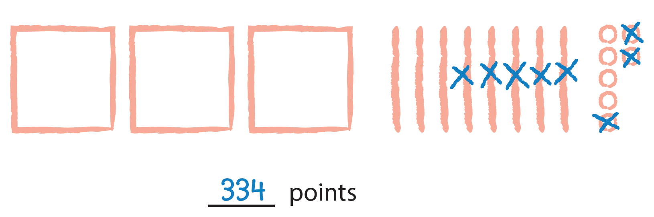
Analyze an Answer
Look at this student’s work. Do you think this student is correct? Why or why not?
© Houghton Mifflin Harcourt Publishing Company
Spark Your Learning
Motivate
3 Reads
Workspace
Persevere
Strategy 1
Strategy 2
Common Error
Turn & Talk
Notes:
This is a possible correct representation.
If students . . . use base-ten blocks and a quick picture to represent subtraction, they are demonstrating understanding of how to use both concrete and visual models to solve a problem.
Have these students . . . share and explain how they solved the problem.
Ask:
-How did you know which blocks to subtract?
-How is using a quick picture like using blocks?
-Why might you choose one strategy instead of the other?

Slide 8
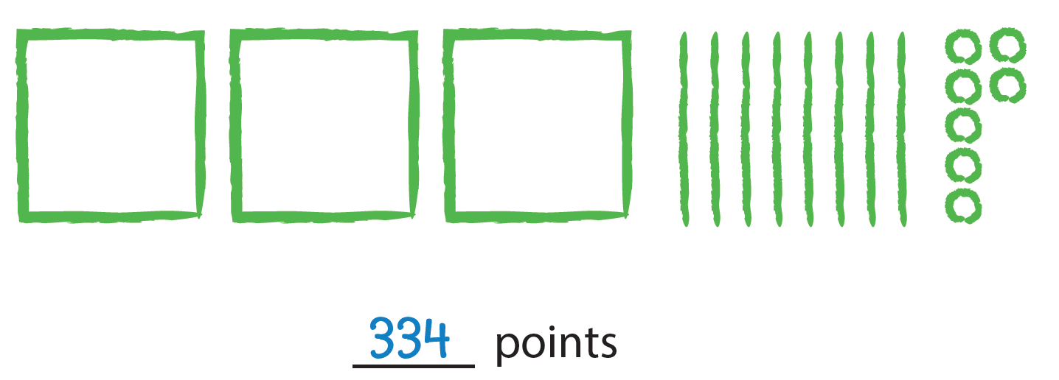
Analyze an Answer
Look at this student’s work. Do you think this student is correct? Why or why not?
© Houghton Mifflin Harcourt Publishing Company
Spark Your Learning
Motivate
3 Reads
Workspace
Persevere
Strategy 1
Strategy 2
Common Error
Turn & Talk
Notes:
This is a possible correct representation.
If students . . . draw a quick picture but do not show subtraction by crossing out, they may not understand the importance of keeping track of their work.
Activate prior knowledge . . . by reminding children that showing their work allows them to keep track of what they have done.
Ask:
-When you used blocks, how did you show subtraction?
-How could you show the same subtraction on your visual model?
-How is showing your work different for a concrete model and a visual model?

Slide 9
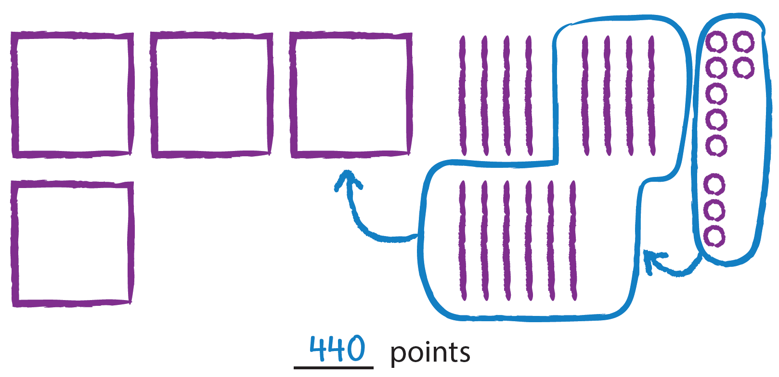
Analyze an Answer
Look at this student’s work. Do you think this student is correct? Why or why not?
© Houghton Mifflin Harcourt Publishing Company
Spark Your Learning
Motivate
3 Reads
Workspace
Persevere
Strategy 1
Strategy 2
Common Error
Turn & Talk
Notes:
This is an incorrect representation where a student adds instead of subtracts.
If students . . . add instead of subtracting, they may not understand the problem.
Then intervene . . . by reviewing the information that is given and the question that is asked.
Ask:
-If Matt's points are less, are there more or fewer?
-What operation represents taking some away to find a lesser number?

Slide 10

Share Your Thinking
Turn and Talk How did you subtract in this problem? How would you subtract if both numbers have two digits?
Noura and Matt play a video game. Noura’s points total has 3 hundreds, 8 tens, 7 ones. Matt’s points total is 5 tens 3 ones less than Noura’s points total.
What is Matt’s point total? Show your work with a visual model.
© Houghton Mifflin Harcourt Publishing Company
Spark Your Learning
Motivate
3 Reads
Workspace
Persevere
Strategy 1
Strategy 2
Common Error
Turn & Talk
Notes:
Ask children to compare subtracting the numbers in this problem to subtracting when both numbers have two digits.
Possible answer: I subtracted the tens and ones in the same way, and I kept the same hundreds digit.

