Slide 1

Spark Your Learning
Grade 1 • Lesson 17.1 – Order Length
Copyright © by Houghton Mifflin Harcourt Publishing Company
All rights reserved. No part of the material protected by this copyright may be reproduced or utilized in any form or by any means, electronic or mechanical, including photocopying, recording, broadcasting or by any other information storage and retrieval system, without written permission of the copyright owner unless such copying is expressly permitted by federal copyright law.
Only those pages that are specifically enabled by the program and indicated by the presence of the print icon may be printed and reproduced in classroom quantities by individual teachers using the corresponding student’s textbook or kit as the major vehicle for regular classroom instruction. Requests for information on other matters regarding duplication of this work should be submitted through our Permissions website at https://customercare.hmhco.com/contactus/Permissions.html or mailed to Houghton Mifflin Harcourt Publishing Company, Attn: Compliance, Contracts, and Licensing, 9400 Southpark Center Loop, Orlando, Florida 32819-8647.
HOUGHTON MIFFLIN HARCOURT and the HMH Logo are trademarks and service marks of Houghton Mifflin Harcourt Publishing Company. You shall not display, disparage, dilute or taint Houghton Mifflin Harcourt trademarks and service marks or use any confusingly similar marks, or use Houghton Mifflin Harcourt marks in such a way that would misrepresent the identity of the owner. Any permitted use of Houghton Mifflin Harcourt trademarks and service marks inures to the benefit of Houghton Mifflin Harcourt Publishing Company.
All other trademarks, service marks or registered trademarks appearing on Houghton Mifflin Harcourt Publishing Company websites are the trademarks or service marks of their respective owners.
Notes:
This PowerPoint file contains instructional aids for teachers who have purchased the Into Math program and who are implementing the Spark Your Learning task in the classroom. It is intended to be projected to students and used in conjunction with the Student Edition and manipulatives as needed. These slides can be used to move the conversation forward in the classroom, but they should not serve as a replacement for student-centered, collaborative conversations in which students have the space they need to find an entry point, construct meaning, and build understanding.

Slide 2


Spark Your Learning
How do you compare objects
of different lengths?
Draw a picture to show the
objects.
© Houghton Mifflin Harcourt Publishing Company • Image Credits: ©Houghton Mifflin Harcourt
Spark Your Learning
Motivate
Workspace
Persevere
Strategy 1
Strategy 2
Common Error
Turn & Talk
Notes:
Use this slide to present the task to students.
Have children each select an object. Then have pairs of children compare the length of their objects. Children draw the objects to show the length then indicate which object is longer and which object is shorter.

Slide 3
Get Motivated
How do you know when objects have length?
How can you measure the lengths of objects?
© Houghton Mifflin Harcourt Publishing Company • Image Credits: ©Houghton Mifflin Harcourt
Spark Your Learning
Motivate
Workspace
Persevere
Strategy 1
Strategy 2
Common Error
Turn & Talk
Notes:
OPTIONAL: Use the questions on this slide to engage students.

Slide 4
Workspace
How do you compare objects
of different lengths?
Draw a picture to show the
objects.
© Houghton Mifflin Harcourt Publishing Company • Image Credits: ©Houghton Mifflin Harcourt
Spark Your Learning
Motivate
Workspace
Persevere
Strategy 1
Strategy 2
Common Error
Turn & Talk
Notes:
Have children each select an object. Then have pairs of children compare the length of their objects. Children draw the objects to show the length then indicate which object is longer and which object is shorter.
Children’s drawings show the length of both objects. Children then indicate which object is longer and which object is shorter.

Slide 5
Persevere
How will you use the objects you choose as tools to compare length?
How do you know an object is longer?
How do you compare objects
of different lengths?
Draw a picture to show the
objects.
© Houghton Mifflin Harcourt Publishing Company • Image Credits: ©Houghton Mifflin Harcourt
Spark Your Learning
Motivate
Workspace
Persevere
Strategy 1
Strategy 2
Common Error
Turn & Talk
Notes:
How will you use the objects you choose as tools to compare length? Possible answer: I will place the objects so their ends line up, so I can compare the lengths.
How do you know an object is longer? Possible answer: The object that has more length than the other object is longer.
BUILD SHARED UNDERSTANDING Select children who used various strategies and tools to share with the class how they solved the problem. Have children discuss why they chose a specific strategy or tool.

Slide 6
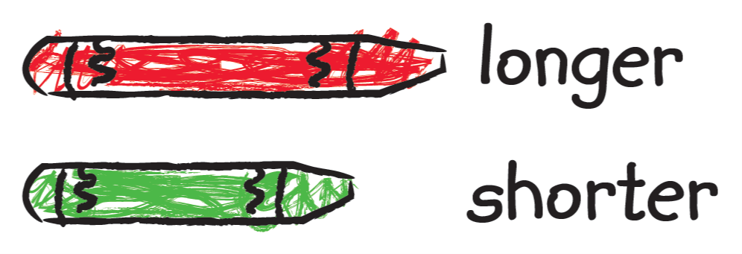
Analyze an Answer
Look at this student’s work. Do you think this student is correct? Why or why not?
© Houghton Mifflin Harcourt Publishing Company
Spark Your Learning
Motivate
Workspace
Persevere
Strategy 1
Strategy 2
Common Error
Turn & Talk
Notes:
This is a possible correct representation.
If children . . . draw two objects aligned at the same starting point and identify their length as longer or shorter, then they have demonstrated they understand how to compare two items using measurable attributes.
Have these children . . . explain why they lined up the objects to have the same starting point.
Ask:
- To compare the lengths, how do you line up the objects?

Slide 7
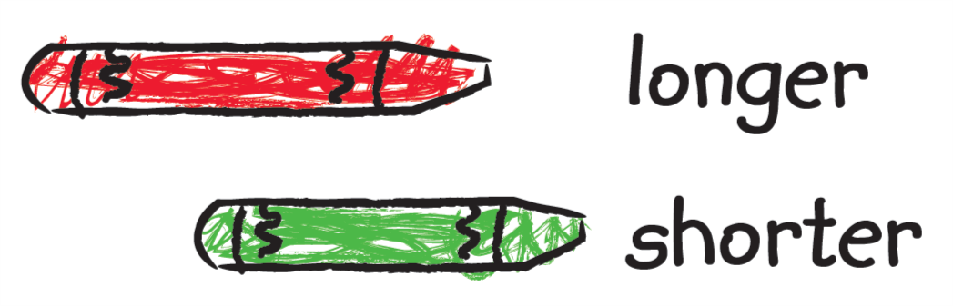
Analyze an Answer
Look at this student’s work. Do you think this student is correct? Why or why not?
© Houghton Mifflin Harcourt Publishing Company
Spark Your Learning
Motivate
Workspace
Persevere
Strategy 1
Strategy 2
Common Error
Turn & Talk
Notes:
This is a possible correct representation.
If children . . . correctly identify the longer object but do not line up the objects from the same starting point, they may not understand the importance of aligning the objects from the same starting point.
Activate prior knowledge . . . by having these children compare the length of two pencils by aligning them.
Ask:
- To compare the lengths, why do you need to line up the objects on the same end?

Slide 8
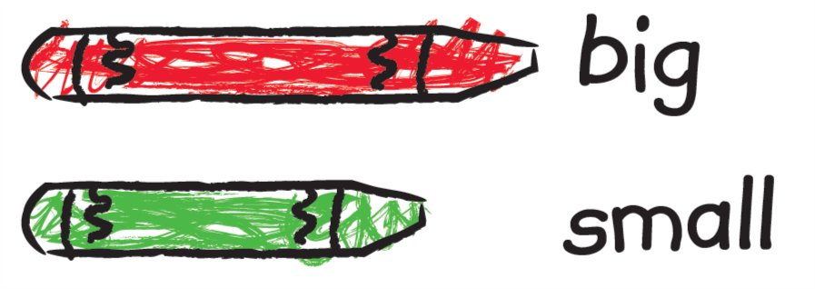
Analyze an Answer
Look at this student’s work. Do you think this student is correct? Why or why not?
© Houghton Mifflin Harcourt Publishing Company
Spark Your Learning
Motivate
Workspace
Persevere
Strategy 1
Strategy 2
Common Error
Turn & Talk
Notes:
This is an incorrect representation where a student uses incorrect language.
If children . . . use the labels big and small, they are not using the right words to communicate length.
Then intervene . . . by showing these children a 3 in. × 4 in. rectangle and a 1 in. × 6 in. rectangle. Ask children if big always means the longest length or if big has other meanings. Discuss the concept of length as measuring how long objects are.
Ask:
- What labels can you use to tell the lengths of objects?

Slide 9

Share Your Thinking
Turn and Talk When you compare lengths of two objects, why is it important to line up the objects on one end?
How do you compare objects
of different lengths?
Draw a picture to show the
objects.
© Houghton Mifflin Harcourt Publishing Company • Image Credits: ©Houghton Mifflin Harcourt
Spark Your Learning
Motivate
Workspace
Persevere
Strategy 1
Strategy 2
Common Error
Turn & Talk
Notes:
Possible answer: If objects start at different points, one object can look like it is longer when it isn’t because there is space between where each object starts.

