Slide 1

Spark Your Learning
Grade K • Lesson 17.1 – Compose 10 Ones and Some More Ones to 14
Copyright © by Houghton Mifflin Harcourt Publishing Company
All rights reserved. No part of the material protected by this copyright may be reproduced or utilized in any form or by any means, electronic or mechanical, including photocopying, recording, broadcasting or by any other information storage and retrieval system, without written permission of the copyright owner unless such copying is expressly permitted by federal copyright law.
Only those pages that are specifically enabled by the program and indicated by the presence of the print icon may be printed and reproduced in classroom quantities by individual teachers using the corresponding student’s textbook or kit as the major vehicle for regular classroom instruction. Requests for information on other matters regarding duplication of this work should be submitted through our Permissions website at https://customercare.hmhco.com/contactus/Permissions.html or mailed to Houghton Mifflin Harcourt Publishing Company, Attn: Compliance, Contracts, and Licensing, 9400 Southpark Center Loop, Orlando, Florida 32819-8647.
HOUGHTON MIFFLIN HARCOURT and the HMH Logo are trademarks and service marks of Houghton Mifflin Harcourt Publishing Company. You shall not display, disparage, dilute or taint Houghton Mifflin Harcourt trademarks and service marks or use any confusingly similar marks, or use Houghton Mifflin Harcourt marks in such a way that would misrepresent the identity of the owner. Any permitted use of Houghton Mifflin Harcourt trademarks and service marks inures to the benefit of Houghton Mifflin Harcourt Publishing Company.
All other trademarks, service marks or registered trademarks appearing on Houghton Mifflin Harcourt Publishing Company websites are the trademarks or service marks of their respective owners.
Notes:
This PowerPoint file contains instructional aids for teachers who have purchased the Into Math program and who are implementing the Spark Your Learning task in the classroom. It is intended to be projected to students and used in conjunction with the Student Edition and manipulatives as needed. These slides can be used to move the conversation forward in the classroom, but they should not serve as a replacement for student-centered, collaborative conversations in which students have the space they need to find an entry point, construct meaning, and build understanding.
GRADE K LESSON 17.1: In this Spark Your Learning task, your objectives are to help students:
Understand the number 13 by decomposing it into 10 ones and 3 more ones using objects.
Use the word thirteen.

Slide 2

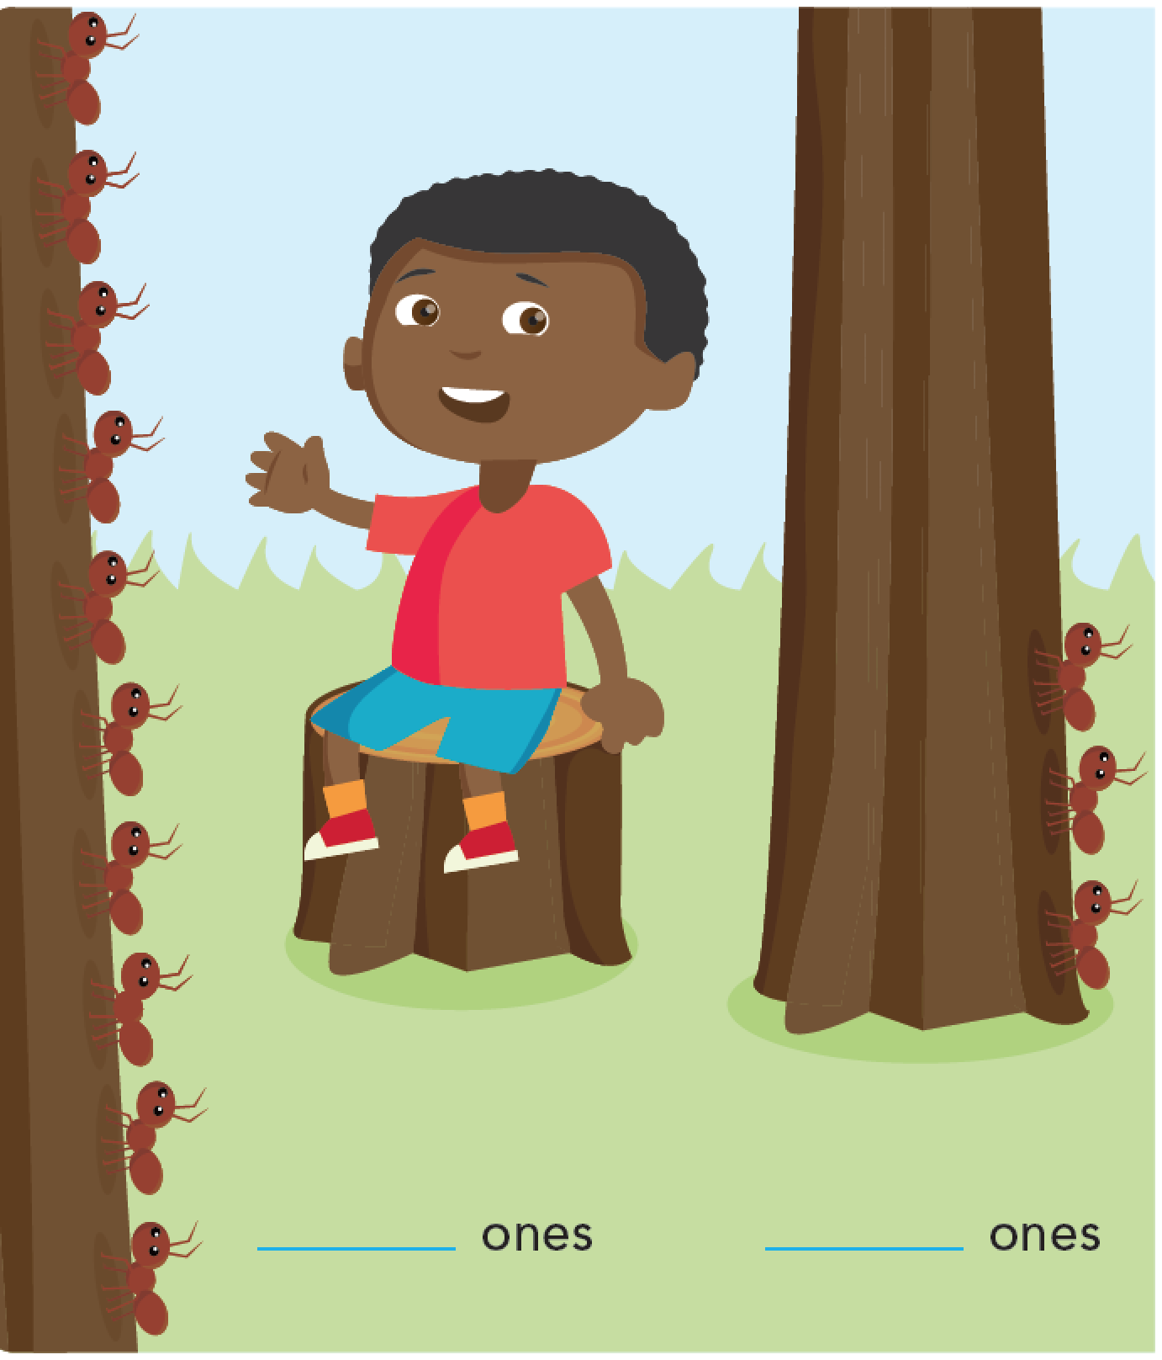
Spark Your Learning
Listen to the story.
Barry sees ants on some trees.
How can you represent the number of ants on each tree?
What do you know about the total number of ants?
Image Credit: ©Houghton Mifflin Harcourt Publishing Company
Spark Your Learning
Motivate
3 Reads
Workspace
Persevere
Strategy 1
Strategy 2
Common Error
Turn & Talk
Notes:
Use this slide to present the task to the children.
Recommended Materials:
Connecting Cubes
Red and Yellow Counters
MathBoards and Dry Erase Markers
Focus on the word “each” when you read the story to help students realize they need to count the ants on the first tree and then count the ants on the second tree separately.
Remind students that they have used counting cubes, counters, and drawings to represent numbers in previous lessons. They can represent the ants the same way.

Slide 3
Get Motivated
What do you see in the picture?
How many trees are there?
Where do ants live?
How many legs does an ant have?
Image Credit: ©Houghton Mifflin Harcourt Publishing Company
Spark Your Learning
Motivate
3 Reads
Workspace
Persevere
Strategy 1
Strategy 2
Common Error
Turn & Talk
Notes:
OPTIONAL: Use the questions on this slide to engage the children.
Accept reasonable answers.
STEM: Where do ants live? Ants live in large groups called colonies. Many ants live underground in a large network of tunnels they build.
STEM: How many legs does an ant have? Ants have six legs.
Consider comparing ants to spiders. Spiders have eight legs.

Slide 4
Three Reads
First Read What is the problem about?
representing the number of ants there are
Second Read What do each of the numbers describe?
There is some number of ants on the first tree, and there is a different number of ants on the second tree.
Third Read What math questions could you ask about the problem?
Possible questions: How many ants are there? Which tree has more ants?
Our question to think about: How can you represent the number of ants on each tree? What do you know about the total number of ants?
Image Credit: ©Houghton Mifflin Harcourt Publishing Company
Spark Your Learning
Motivate
3 Reads
Workspace
Persevere
Strategy 1
Strategy 2
Common Error
Turn & Talk
Notes:
OPTIONAL: Use the 3 Reads Language Routine to help the children understand the question.
Read the problem stem to the children three times and prompt the children with a different question each time.
Problem Stem: Barry sees ants on some trees. How can you represent the number of ants on each tree? What do you know about the total number of ants?
After the Third Read, remind students that they have used counting cubes, counters, and drawings to represent numbers in previous lessons. They can represent the ants the same way.

Slide 5


Workspace
Image Credit: ©Houghton Mifflin Harcourt Publishing Company
Spark Your Learning
Motivate
3 Reads
Workspace
Persevere
Strategy 1
Strategy 2
Common Error
Turn & Talk
Notes:
Give children time to explore various representations and the tools available to them.
You may prompt students to represent the ants using two different types of tools, such as with counters or drawings and then with connecting cubes.
If students are struggling, use the Persevere slide.
Help students see how connecting cubes can be used to represent the ants by clicking to reveal the red and blue cubes, one at a time. Make sure to stop after the ten red cubes and start over with the number 1 as you count the blue cubes. There are 13 ants, or 13 cubes, but focus on representing 13 as 10 ones and 3 ones.
Children have seen Five Frames and Ten Frames previously, and some may want to organize their representations using two Ten Frames. Let this occur naturally for those children who are ready. Representations with Ten Frames will be introduced and explored in the next Module.
What do you know about the total number of ants? There are 13 ants, which I can represent as 10 ones and 3 more ones.

Slide 6
Persevere
What do you need to do to solve the problem?
What tools could you use to represent the ants?
How many ants are on the first tree?
How can you show this?
How many ants are on the second tree?
How can you show this?
How can you show that the two groups are separate in your representation?
What do you know about the total number of ants?
Image Credit: ©Houghton Mifflin Harcourt Publishing Company
Spark Your Learning
Motivate
3 Reads
Workspace
Persevere
Strategy 1
Strategy 2
Common Error
Turn & Talk
Notes:
Just-In-Time Scaffolding: These questions can be used to move the conversation forward if children are struggling.
Problem Stem: Barry sees ants on some trees. How can you represent the number of ants on each tree? What do you know about the total number of ants?
What do you need to do to solve the problem? Possible answer: represent the number of ants on each tree
What tools could you use to represent the ants? Choices of strategies or tools may vary and could include using drawings, counters, or connecting cubes
How many ants are on the first tree? How can you show this? There are 10 ants on the first tree. Possible answer: I can draw 10 circles or tally marks.
How many ants are on the second tree? How can you show this? There are 3 ants on the second tree. Possible answer: I can draw 3 circles or tally marks.
How can you show that the two groups are separate in your representation? Possible answer: I can circle the group of 10.
What do you know about the total number of ants? There are 13 ants, which I can represent as 10 ones and 3 more ones.
BUILD SHARED UNDERSTANDING Select children who have used various strategies and tools to share with the class how they solved the problem. Have children discuss why they chose a specific strategy or tool. Use the connecting cubes on the Workspace slide to ensure all students see a correct representation. Other possible correct representations are shown on Slide 11.
Ensure students write the numbers 10 and 3 in the blanks on their Student Edition page.

Slide 7
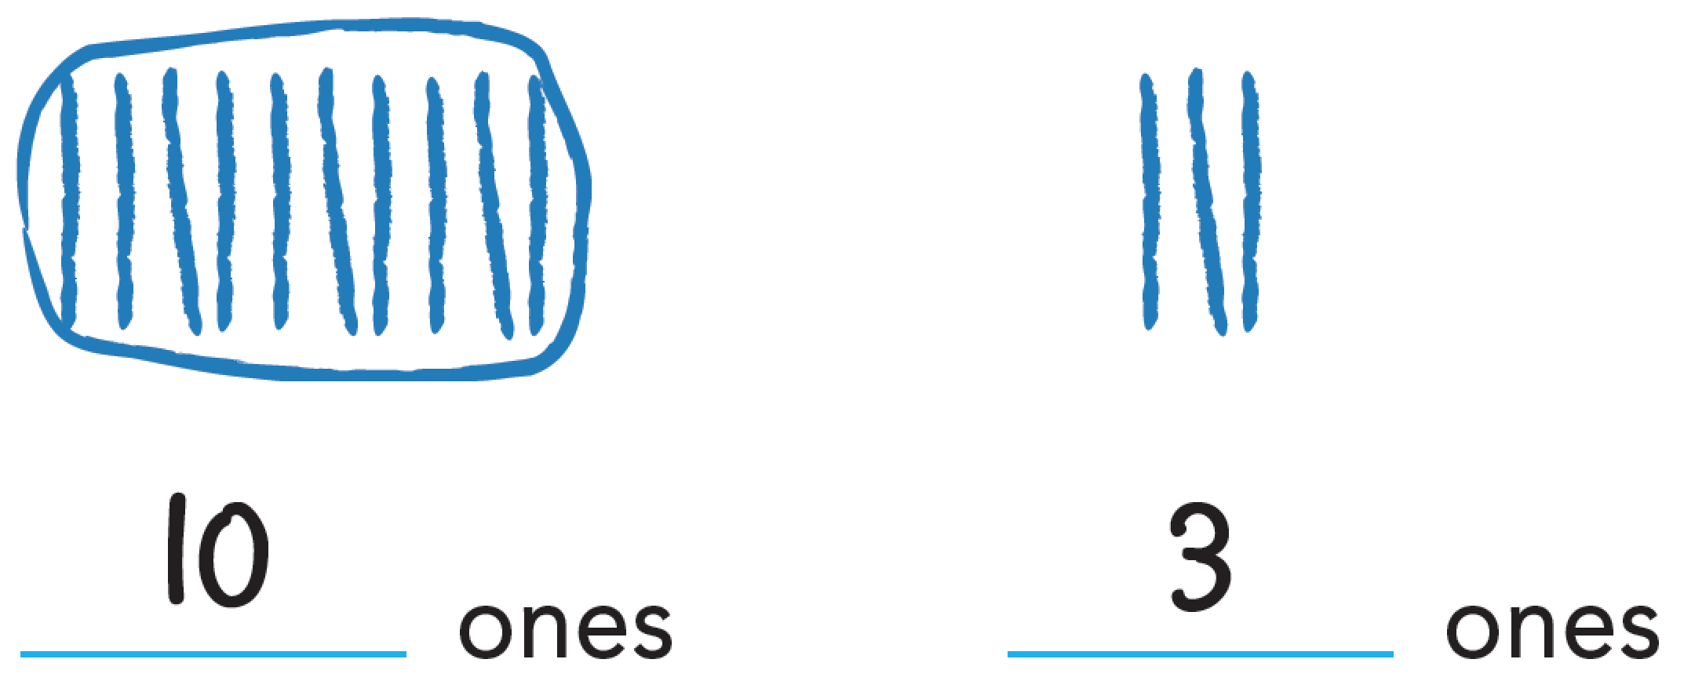
Analyze an Answer
Look at this student’s work. Do you think this student is correct? Why or why not?
Image Credit: ©Houghton Mifflin Harcourt Publishing Company
Spark Your Learning
Motivate
3 Reads
Workspace
Persevere
Strategy 1
Strategy 2
Common Error
Turn & Talk
Notes:
Children may have used other tools to draw or represent the ants. Discuss other possible correct representations, or show students Slide 11.
If children . . . accurately count and represent the number 13 by writing 10 ones and 3 ones, they have demonstrated understanding of how to compose and represent numbers of 10 ones and some more ones.
Have these children . . . explain why they chose to represent 13 in the way that they did.
Ask:
What are some other ways that you can show how to represent 13 using 10 ones and 3 ones?

Slide 8
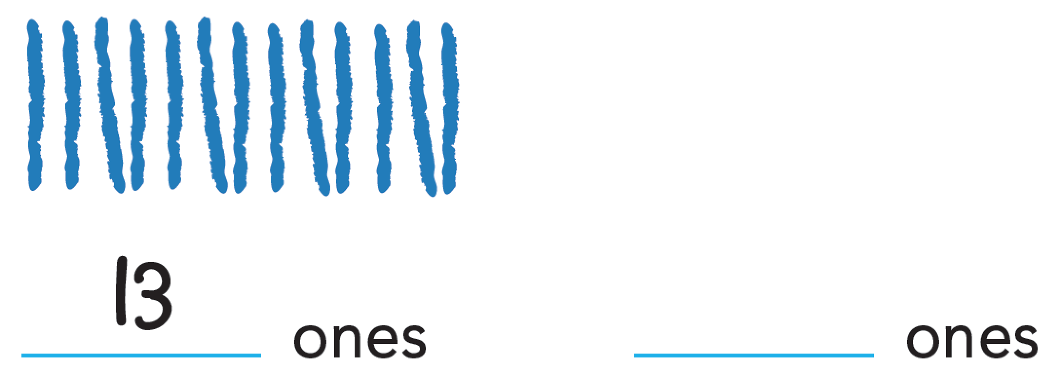
Analyze an Answer
Look at this student’s work. Do you think this student is correct? Why or why not?
Image Credit: ©Houghton Mifflin Harcourt Publishing Company
Spark Your Learning
Motivate
3 Reads
Workspace
Persevere
Strategy 1
Strategy 2
Common Error
Turn & Talk
Notes:
If children . . . represent the number 13 without separating the 10 ones, they may not understand how to compose a number of 10 ones and some more ones.
Activate prior knowledge . . . by explaining that the number can be composed using two groups: 10 ones and 3 more ones. Tell children that starting with 10 ones makes it easier to count and describe.
Ask:
How can you draw your picture to clearly show that there is a group of 10 ones and a group of 3 more ones?
How can you use numbers to show the two groups?

Slide 9
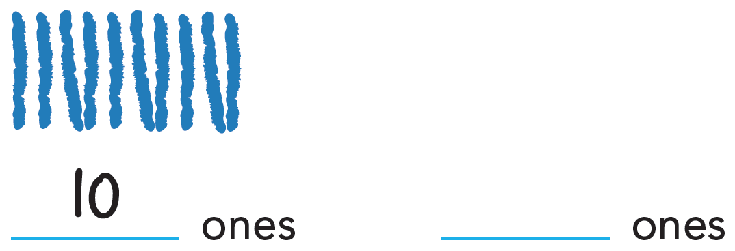
Analyze an Answer
Look at this student’s work. Do you think this student is correct? Why or why not?
Image Credit: ©Houghton Mifflin Harcourt Publishing Company
Spark Your Learning
Motivate
3 Reads
Workspace
Persevere
Strategy 1
Strategy 2
Common Error
Turn & Talk
Notes:
If children . . . only draw one of the parts (10 or 3), they may not understand that they are supposed to represent all of the ants.
Then intervene. . . by counting the total number of ants on both trees. Point out that there are 13 in all. Tell children that their representation should show a group of 10 ones and a group of 3 ones.
Ask:
There are ten ants on one tree and three ants on the other tree. How can you show that these two numbers represent the number 13?

Slide 10

Share Your Thinking
Turn and Talk Discuss your representation with a partner. How are they alike? How are they different?
Image Credit: ©Houghton Mifflin Harcourt Publishing Company
Spark Your Learning
Motivate
3 Reads
Workspace
Persevere
Strategy 1
Strategy 2
Common Error
Turn & Talk
Notes:
Ensure children have an opportunity to share their thinking with a partner.

Slide 11
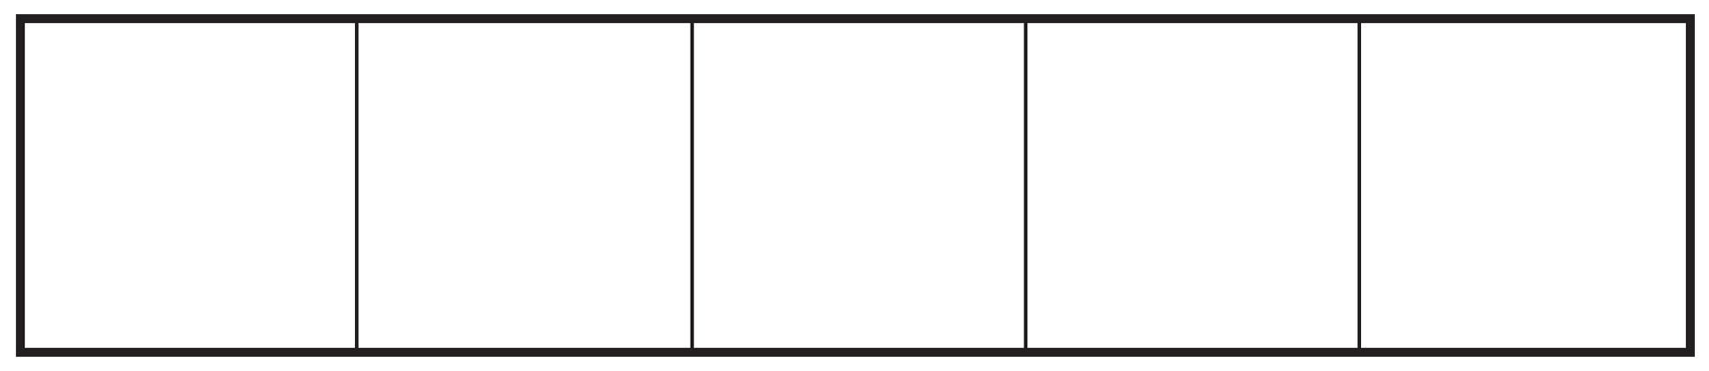





Some Possible Representations
10 ones
10 ones
and
and
3 ones
3 ones
10 ones
10 ones
and
3 ones
and
3 ones
Image Credit: ©Houghton Mifflin Harcourt Publishing Company
Notes:
Use this slide to discuss other ways you could represent 13 as 10 ones and 3 ones.

